Slide 1
Clusters in Chaos: A Deep Unsupervised Learning Paradigm for Network Anomaly Detection
Krishnaa S (2020506045) Jawahar A S (2020506035) Thamizharasi M (2020506102)
Under the guidance of
Dr. P. Kola Sujatha

Slide 2
PROBLEM STATEMENT
With the ever-increasing sophistication of cyberattacks, traditional security measures are struggling to keep pace, leaving networks vulnerable to disruptions, data breaches, and financial losses. Hence, an intelligent system capable of detecting anomalous network behaviour is crucial for identifying these threats before they can cause significant damage.

Slide 3
OBJECTIVES
Analyse and understand the NSL KDD dataset.
Develop a deep unsupervised learning model.
Optimize the clustering techniques and evaluate the model.

Slide 4
LITERATURE SURVEY
 | Description | Pros and Cons
1 | ARCADE: Adversarially Regularized Convolutional Autoencoder for Network Anomaly Detection Published in: IEEE Transactions on Network and Service Management , IEEE Year: 2023 Authors: Willian Tessaro Lunardi, Martin Andreoni Lopez, Jean-Pierre Giacalone About: ARCADE, an unsupervised deep learning detection system for network anomaly detection. ARCADE uses a convolutional Autoencoder to build a profile of normal traffic and detect potential anomalies and intrusions efficiently. | Pros: ARCADE achieves nearly 100% F1-score for detecting malicious traffic. ARCADE's 20 times fewer parameters result in faster detection speed. Adversarial strategy is adaptable to various autoencoder architectures. Cons: ARCADE shows lower F1-scores (68.70% and 66.61%) for HTTP DOS, DDOS attacks. Relying on two initial packets may hinder accuracy in some cases. Computational overhead may occur during training, affecting efficiency.
2 | A Deep Learning Approach to Network Intrusion Detection Published in: IEEE Transactions on Emerging Topics in Computational Intelligence Year: 2018 Authors: Nathan Shone , Tran Nguyen Ngoc, Vu Dinh Phai , and Qi Shi About: Utilizes TensorFlow to implement a Deep Belief Network (DBN) for efficient network anomaly detection, tackling challenges in Network Intrusion Detection Systems (NIDS). It introduces Non-Symmetric Dimensionality Auto-Encoder (NDAE) for enhanced feature learning, outperforming DBNs, and employs stacked NDAE with Random Forest for superior classification. | Pros: Up to 5% accuracy improvement and 98.81% training time reduction. High precision, recall, and accuracy on KDD Cup '99 and NSL-KDD datasets. Addresses concerns in human interaction and detection accuracy for modern NIDSs. Cons: Acknowledges imperfections, indicating potential for further refinement. Untested in handling zero-day attacks and real-world backbone network traffic. Relies on TensorFlow and GPU, limiting applicability in resource-constrained environments.

Slide 5
LITERATURE SURVEY
 | Description | Pros and Cons
3 | Clustering and Unsupervised Anomaly Detection with L2 Normalized Deep Auto-Encoder Representations Published in: 2018 International Joint Conference on Neural Networks (IJCNN), IEEE Year: 2018 Authors: Caglar Aytekin; Xingyang Ni; Francesco Cricri; Emre Aksu About: Uses L2 normalization in auto-encoder training to enhance clustering and anomaly detection by improving accuracy. The method adds this constraint, boosting accuracy in grouping information. The computer learns from dense or convolutional layers and minimizes errors during training for better results. | Pros: L2 normalization improves representation separability for higher k-means clustering accuracy. Anomaly detection method using L2 normalized auto-encoder representations outperforms other deep methods. Achieves high clustering accuracy without additional clustering losses, offering a straightforward approach. Cons: Relies on L2 normalization, limiting applicability in some scenarios. Focuses on weaknesses in reconstruction error-based anomaly detection, leaving room for broader exploration.
4 | Unsupervised Detection of Anomalous Running Patterns Using Cluster Analysis Published in: 2023 IEEE 13th International Conference on Electronics and Information Technologies (ELIT) Year: 2023 Authors: Ivan Ursul; Andriy Pereymybida About: Examines methods for finding unusual patterns in groups, covering different techniques like distance-based, hierarchical, and density-based approaches. It also talks about using teamwork (ensemble) and spotting outliers to get better at finding unusual things in a specific dataset. | Pros: Performance evaluation identifies DBSCAN as the most efficient for detecting anomalous running patterns. Provides actionable insights for improving individual and group running performance based on detected anomalies. Cons: Unable to detect cheating due to dataset limitations. Some algorithms may face computational slowness on large datasets. Suggests using additional telemetry data for enhanced cheating detection, introducing dependency on external sources.

Slide 6
LITERATURE SURVEY
 | Description | Pros and Cons
5 | Detecting Network Transmission Anomalies using Autoencoders-SVM Neural Network on Multi-class NSL-KDD Dataset Published in: 2023 IEEE 13th Annual Computing and Communication Workshop and Conference (CCWC) Year: 2023 Authors: Shehram Sikander Khan; Akalanka Bandara Mailewa About: Examines methods for finding unusual patterns in groups, covering different techniques like distance-based, hierarchical, and density-based approaches. It also talks about using teamwork (ensemble) and spotting outliers to get better at finding unusual things in a specific dataset. | Pros: DAE-SVM outperforms PCA-SVM, especially in identifying low-frequency attacks. L1 regularization proves effective, and the model works well without any penalty term in a multi-class scenario. Cons: Evaluation is based on NSL-KDD, and generalizability to other datasets needs further validation. Acknowledges the need for future research to explore additional architectures and industry-specific requirements in Industry 4.0.

Slide 7
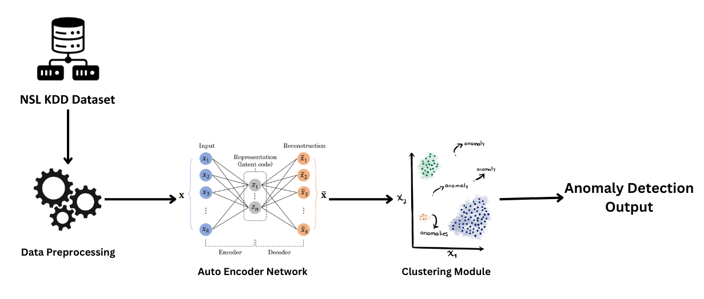
ARCHITECTURE DIAGRAM

Slide 8
MODULES
Module 1: Dataset exploration, Analysis and Preprocessing
Explore dataset characteristics.
Analyse and preprocess NSL-KDD dataset.
Implement data cleaning, scaling, and normalization.
Module 2: Autoencoder Model Development
Design deep autoencoder architecture.
Implement and train autoencoder model on pre-processed data.
Evaluate model using reconstruction error metrics.
Module 3: Anomaly Detection Using Reconstruction Comparison
Set up thresholding mechanism based on reconstruction error.
Determine criteria for identifying anomalies.

Slide 9
MODULES
Module 4: Clustering Integration
Choose and implement suitable clustering algorithms.
Fine-tune clustering parameters for optimal performance.
Module 5: Evaluation and Model Refinement
Evaluate the complete anomaly detection system using appropriate metrics.
Refine the model based on evaluation results.

Slide 10
PROJECT ENVIRONMENT
Windows 10/11
Python
Google Colab / Jupyter Notebook

Slide 11
BENIFITS
1. Early Detection of Security Threats: Enabling proactive responses to potential intrusions, unauthorized access, and malicious activities.
2. Swift Incident Response: Reduce response time to security incidents by swiftly identifying and classifying abnormal network patterns.
3. Improved Operational Resilience: Mitigate issues such as congestion, performance degradation, and service disruptions, ensuring a more robust and reliable network infrastructure.
4. Resource Optimization and Efficiency: Aids in resource optimization by identifying and addressing bandwidth-hogging activities and other network resource misuses.

Slide 12
REFERENCES
W. T. Lunardi, M. A. Lopez and J. -P. Giacalone, "ARCADE: Adversarially Regularized Convolutional Autoencoder for Network Anomaly Detection," in IEEE Transactions on Network and Service Management, vol. 20, no. 2, pp. 1305-1318, June 2023, doi: 10.1109/TNSM.2022.3229706. keywords: {Anomaly detection;Training;Telecommunication traffic;Generative adversarial networks;Data models;Generators;Deep learning;Unsupervised anomaly detection;autoencoder;generative adversarial networks;automatic feature extraction;deep learning;cybersecurity},
N. Shone, T. N. Ngoc, V. D. Phai and Q. Shi, "A Deep Learning Approach to Network Intrusion Detection," in IEEE Transactions on Emerging Topics in Computational Intelligence, vol. 2, no. 1, pp. 41-50, Feb. 2018, doi: 10.1109/TETCI.2017.2772792. keywords: {Machine learning;Intrusion detection;Anomaly detection;Training data;Communication networks;Monitoring;Deep learning;anomaly detection;auto-encoders;KDD;network security},
C. Aytekin, X. Ni, F. Cricri and E. Aksu, "Clustering and Unsupervised Anomaly Detection with l2 Normalized Deep Auto-Encoder Representations," 2018 International Joint Conference on Neural Networks (IJCNN), Rio de Janeiro, Brazil, 2018, pp. 1-6, doi: 10.1109/IJCNN.2018.8489068. keywords: {Training;Anomaly detection;Neural networks;Image reconstruction;Encoding;Clustering algorithms;Clustering methods},
I. Ursul and A. Pereymybida, "Unsupervised Detection of Anomalous Running Patterns Using Cluster Analysis," 2023 IEEE 13th International Conference on Electronics and Information Technologies (ELIT), Lviv, Ukraine, 2023, pp. 148-152, doi: 10.1109/ELIT61488.2023.10310751. keywords: {Performance evaluation;Wearable computers;Scalability;Clustering algorithms;Network intrusion detection;Optics;Telemetry;clusters;anomaly detection;unsupervised learning},
S. S. Khan and A. B. Mailewa, "Detecting Network Transmission Anomalies using Autoencoders-SVM Neural Network on Multi-class NSL-KDD Dataset," 2023 IEEE 13th Annual Computing and Communication Workshop and Conference (CCWC), Las Vegas, NV, USA, 2023, pp. 0835-0843, doi: 10.1109/CCWC57344.2023.10099056. keywords: {Support vector machines;Training;Computational modeling;Neural networks;Predictive models;Feature extraction;Security;NSL-KDD;Network Security;Intrusion Detection System;Deep Autoencoders;Anomaly Detection;Support Vector Machine (SVM);t-SNE;Deep Learning},

Slide 13
REFERENCES
W. Xu, J. Jang-Jaccard, A. Singh, Y. Wei and F. Sabrina, "Improving Performance of Autoencoder-Based Network Anomaly Detection on NSL-KDD Dataset," in IEEE Access, vol. 9, pp. 140136-140146, 2021, doi: 10.1109/ACCESS.2021.3116612. keywords: {Anomaly detection;Data models;Training;Network security;Mathematical models;Encoding;Task analysis;Network security;intrusion detection systems;network-based IDSs;anomaly detection;NSL-KDD;artificial intelligence;machine learning;deep learning;autoencoders;unsupervised learning},
C. Maudoux and S. Boumerdassi, "Network Anomalies Detection by Unsupervised Activity Deviations Extraction," 2022 Global Information Infrastructure and Networking Symposium (GIIS), Argostoli, Greece, 2022, pp. 1-5, doi: 10.1109/GIIS56506.2022.9937022. keywords: {Clustering algorithms;Organizations;Computer crime;Anomaly detection;Sports;Geohash;anomalies detection;activity deviation;unsupervised machine learning;networks;aggregation;security},

Slide 14


